Slide 1
Methylation in Cancer
Anders Berglund, PhD
Collaborative Bioinformatician
Associate Professor of Biomedical Bioinformatics
Senior Associate Consultant II
Division of Computational Biology
Department of Quantitative Health Sciences
The Mayo Clinic Jacksonville

Slide 2
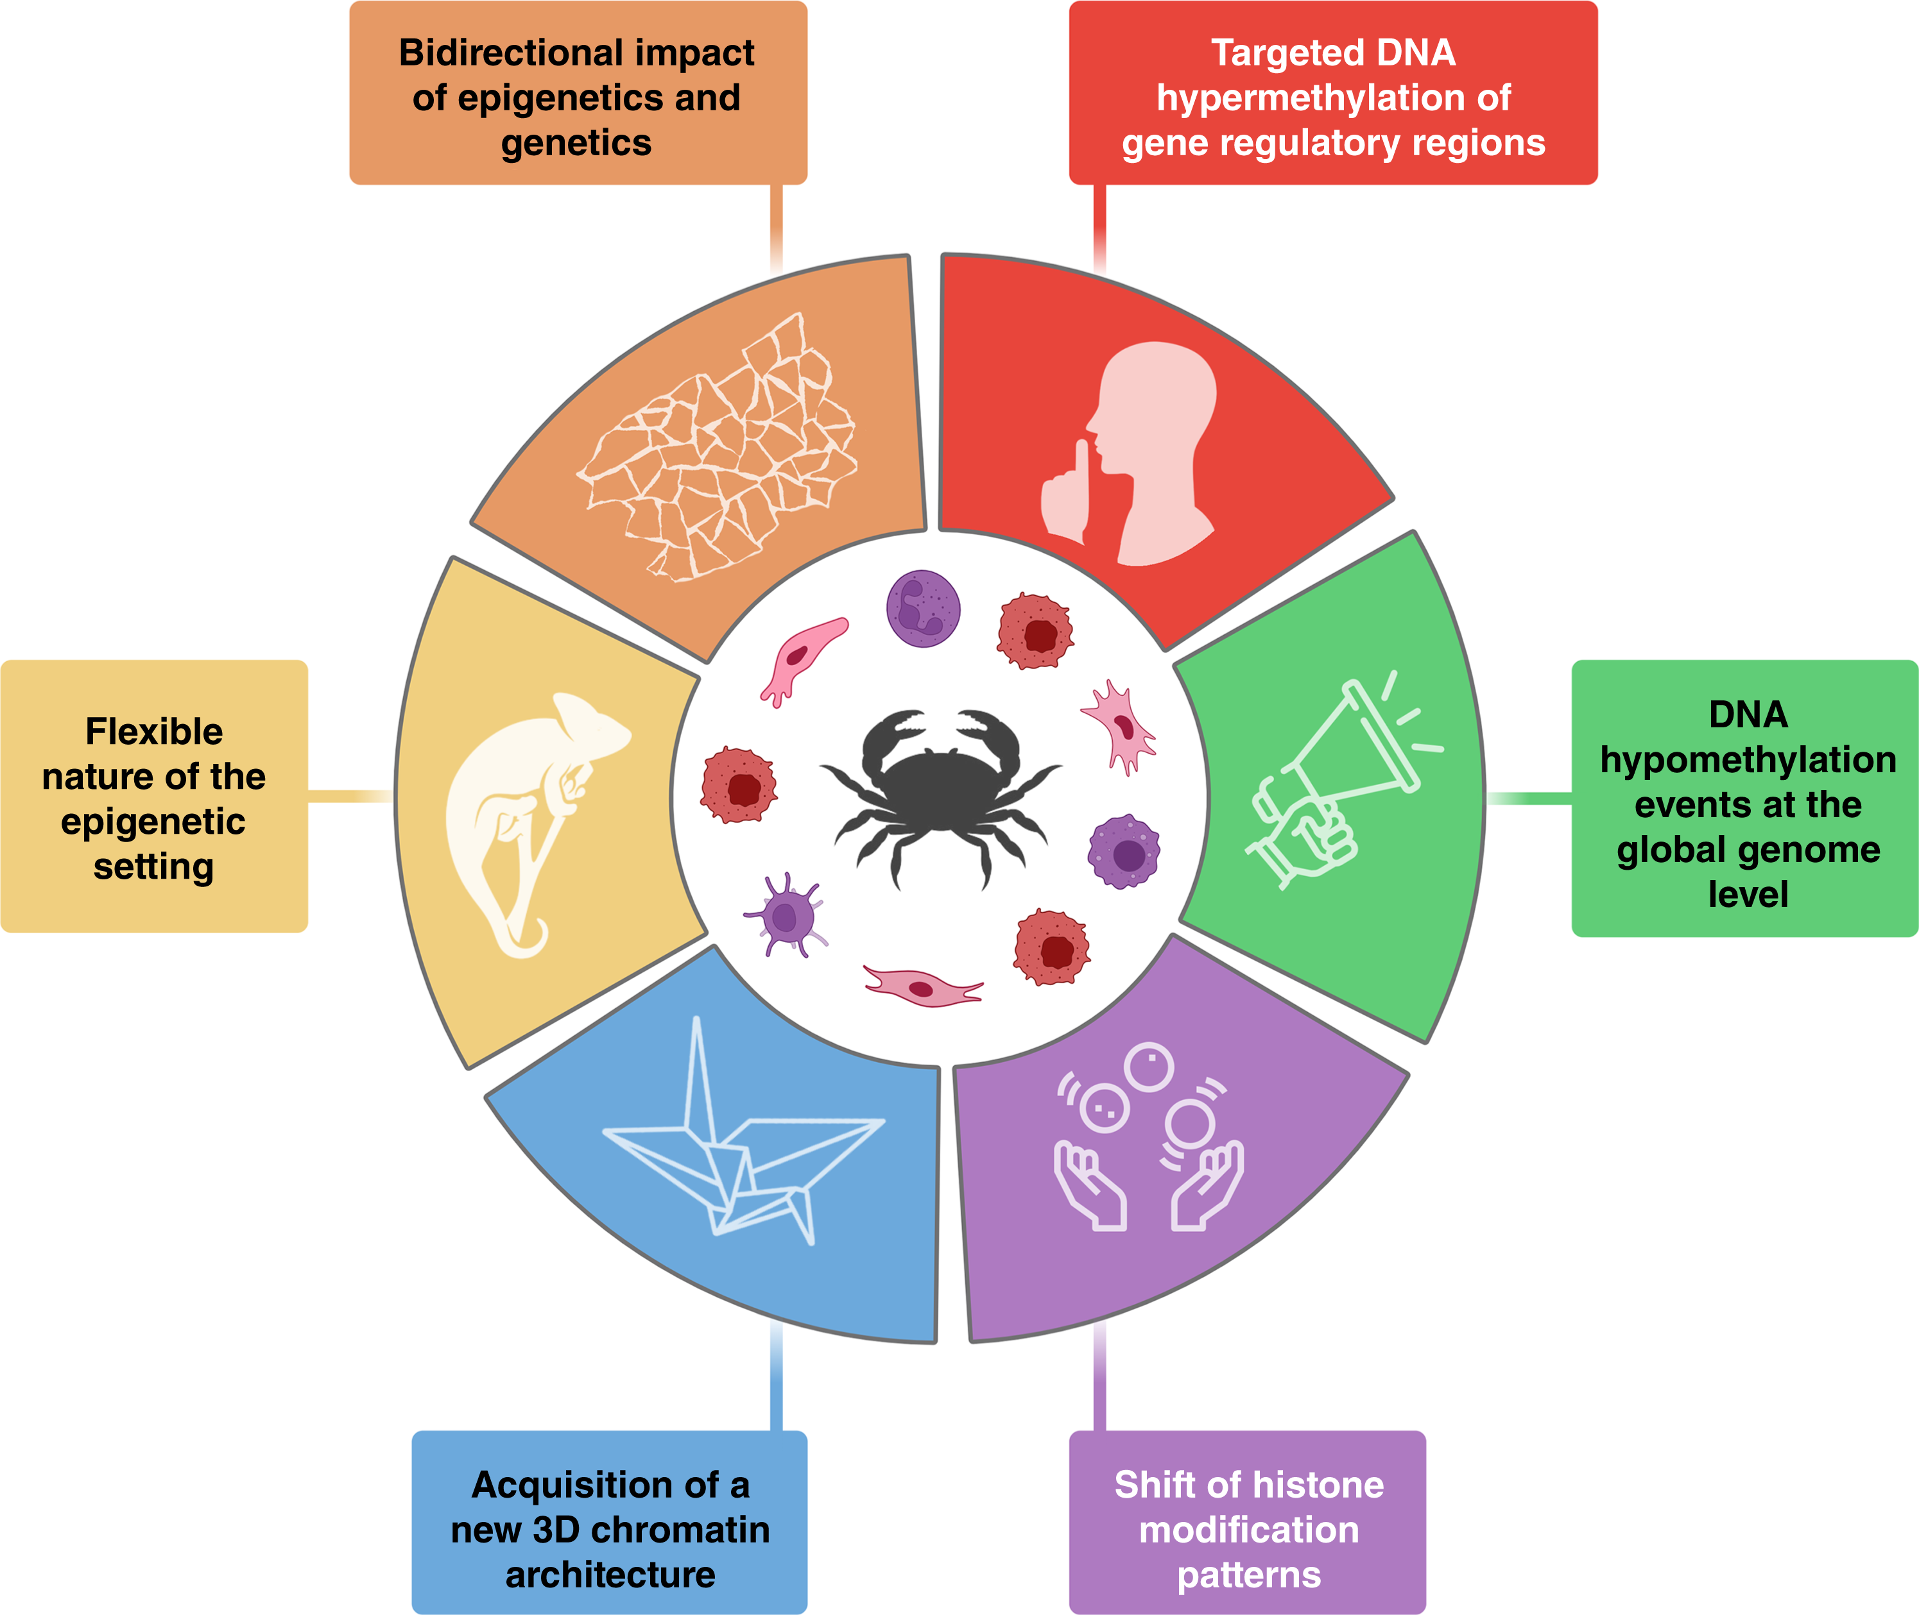
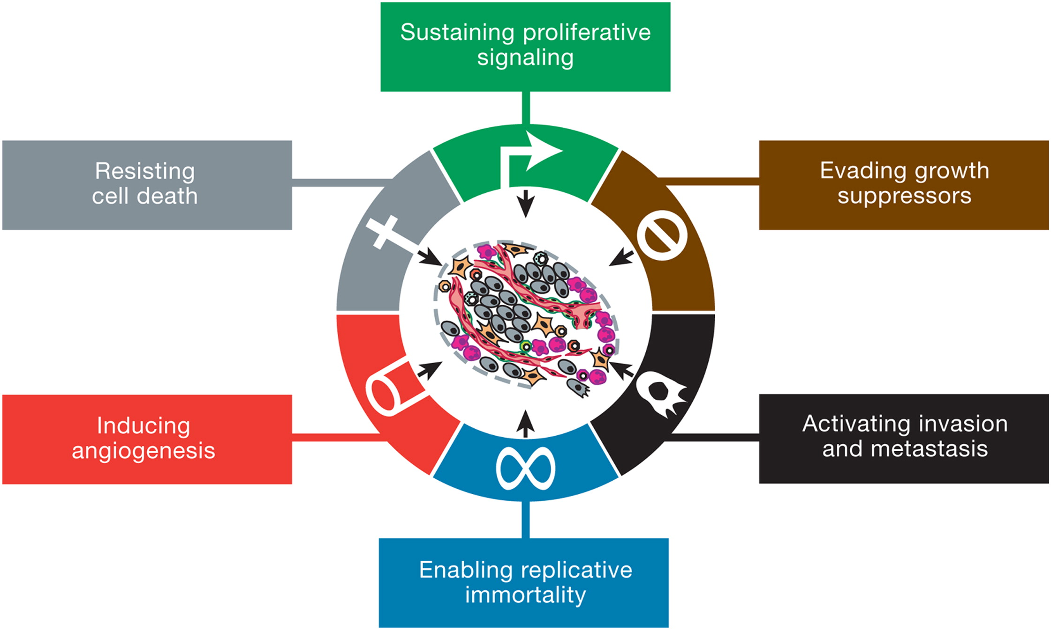
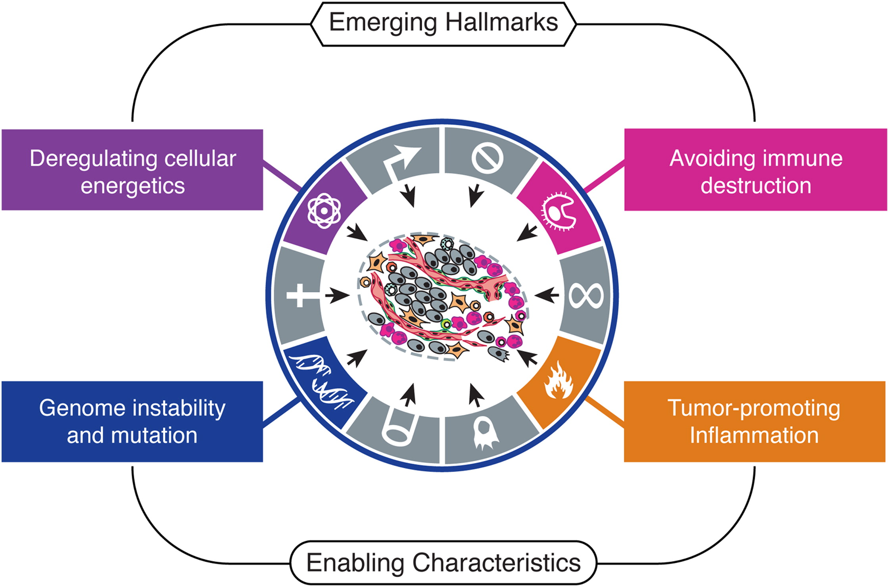
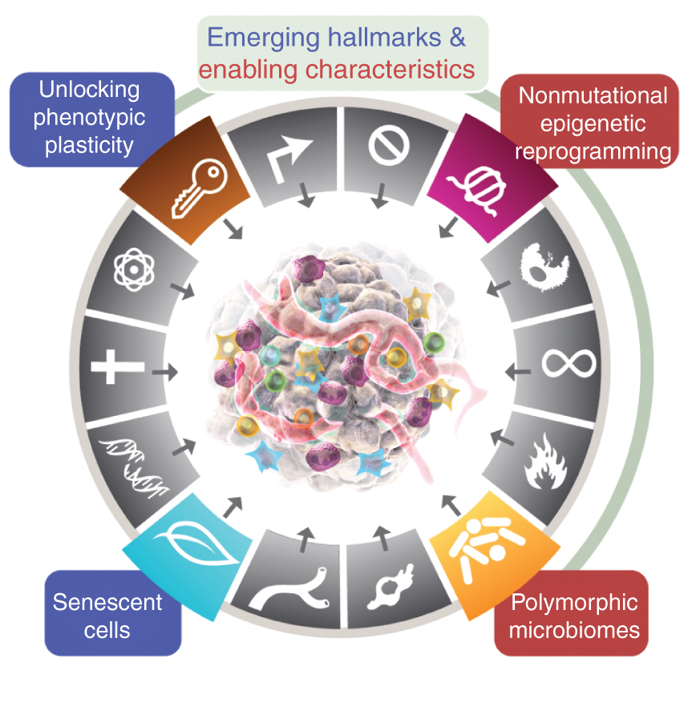
The Hallmarks of Cancer
Hanahan & Weinberg
Cell 2000
The Epigenetic Hallmarks of Cancer
Esteller,
Cancer Discovery 2024
Hallmarks of Cancer: New Dimensions
Hanahan,
Cancer Discovery 2022
Hallmarks of Cancer: The Next Generation
Hanahan & Weinberg
Cell 2011

Slide 3
“Epigenetics is the study of heritable phenotype changes that do not involve alterations in the DNA sequence[1].”
“As such, the term ‘epigenetics’ has solid roots in describing how a cell retains memory of past states and perturbations[2].”
xkcd.com/2298/
Dupont C, Armant DR, Brenner CA (2009). "Epigenetics: definition, mechanisms and clinical perspective". Seminars in Reproductive Medicine. 27 (5): 351–57
Henikoff, S., & Greally, J. M. (2016). Epigenetics, cellular memory and gene regulation. Current biology, 26(14), R644-R648.

Slide 4
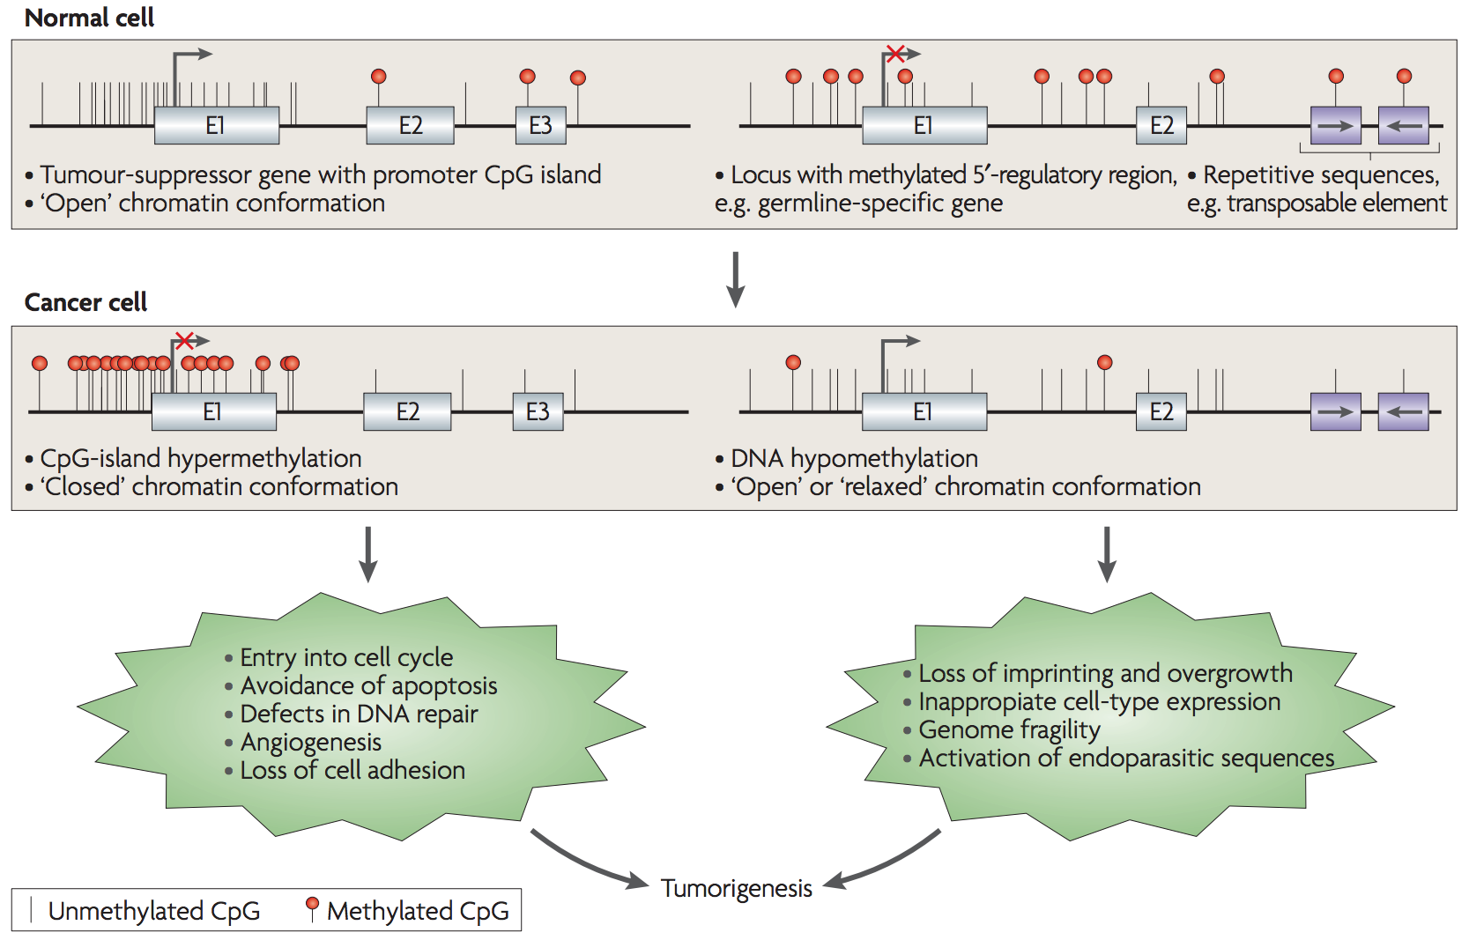
CpG island
Methylation
Multiple CpG-sites for each gene
Different parts of the gene structure
Both hyper and hypo methylation are important
Esteller M. Cancer epigenomics: DNA methylomes and histone-modification maps. Nat Rev Genet. 2007;8(4):286-98.

Slide 5
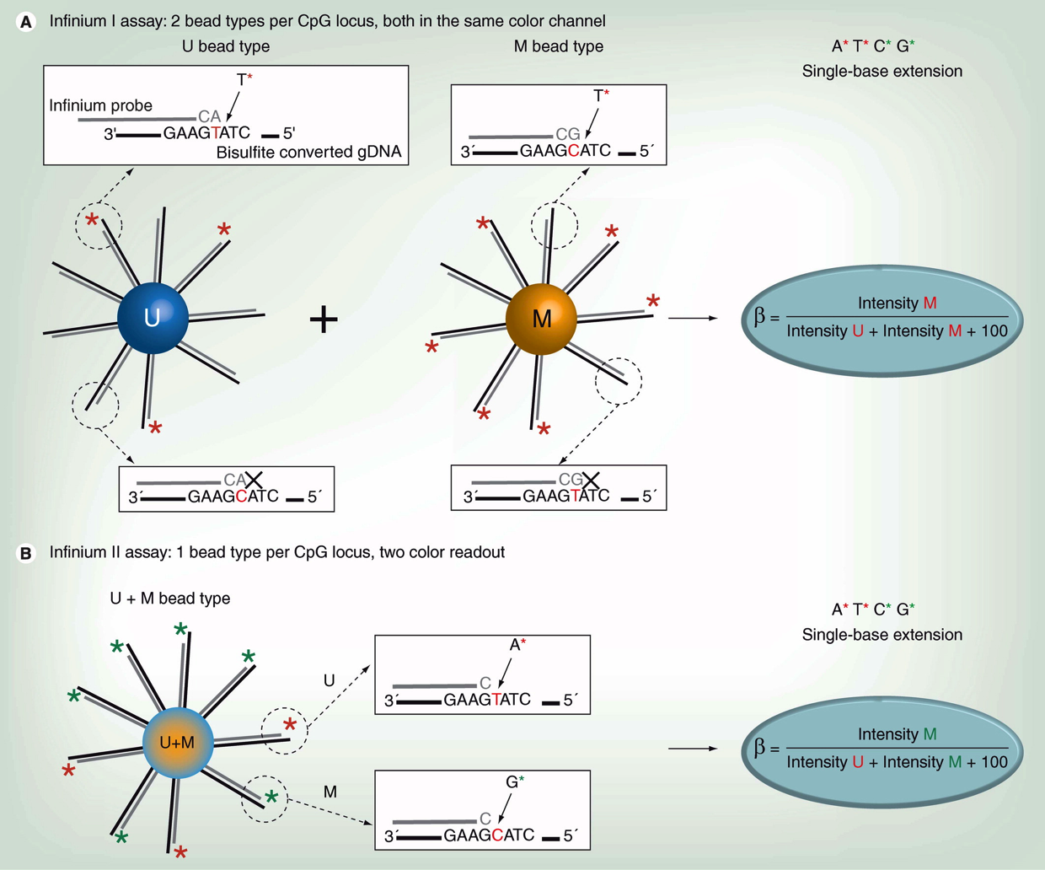
Illumina's Infinium 27K/450K / EPIC/EPICv2 HumanMethylation Array
Illumina methylation array
Two assays¹
SNP probes, rs-probes
450K: 480K CpG-probes², TCGA
EPIC: 850K CpG-probes
EPICv2: 920K CpG-probes, somatic mutations, multiple CpG-probes for the same position, cg00017461_BC12
β–value
Degree of methylation
M-value M=log₂(β /(1− β))
Annotation of the probes
Cross hybridization, SNP sites and other issues^{3,4}
Normalization
Many methods available
Usual problems⁵
Batch effects
How to interpret the results
Dedeurwaerder S, et al: Evaluation of the Infinium Methylation 450K technology. Epigenomics 2011, 3:771-784.
Bibikova M, et al: High density DNA methylation array with single CpG site resolution. Genomics 2011, 98:288-295.
Chen Y-a, et al: Discovery of cross-reactive probes and polymorphic CpGs in the Illumina Infinium HumanMethylation450 microarray. Epigenetics 2013, 8:203-209.
Price EM, et al: Additional annotation enhances potential for biologically-relevant analysis of the Illumina Infinium HumanMethylation450 BeadChip array. Epigenetics & Chromatin 2013, 6:4.
Harper KN, et al: Batch Effects and Pathway Analysis: Two Potential Perils in Cancer Studies Involving DNA Methylation Array Analysis. Cancer Epidemiology Biomarkers & Prevention 2013, 22:1052-1060.
Taken from Dedeurwaerder S, et al. Epigenomics 2011, 3:771-784.

Slide 6
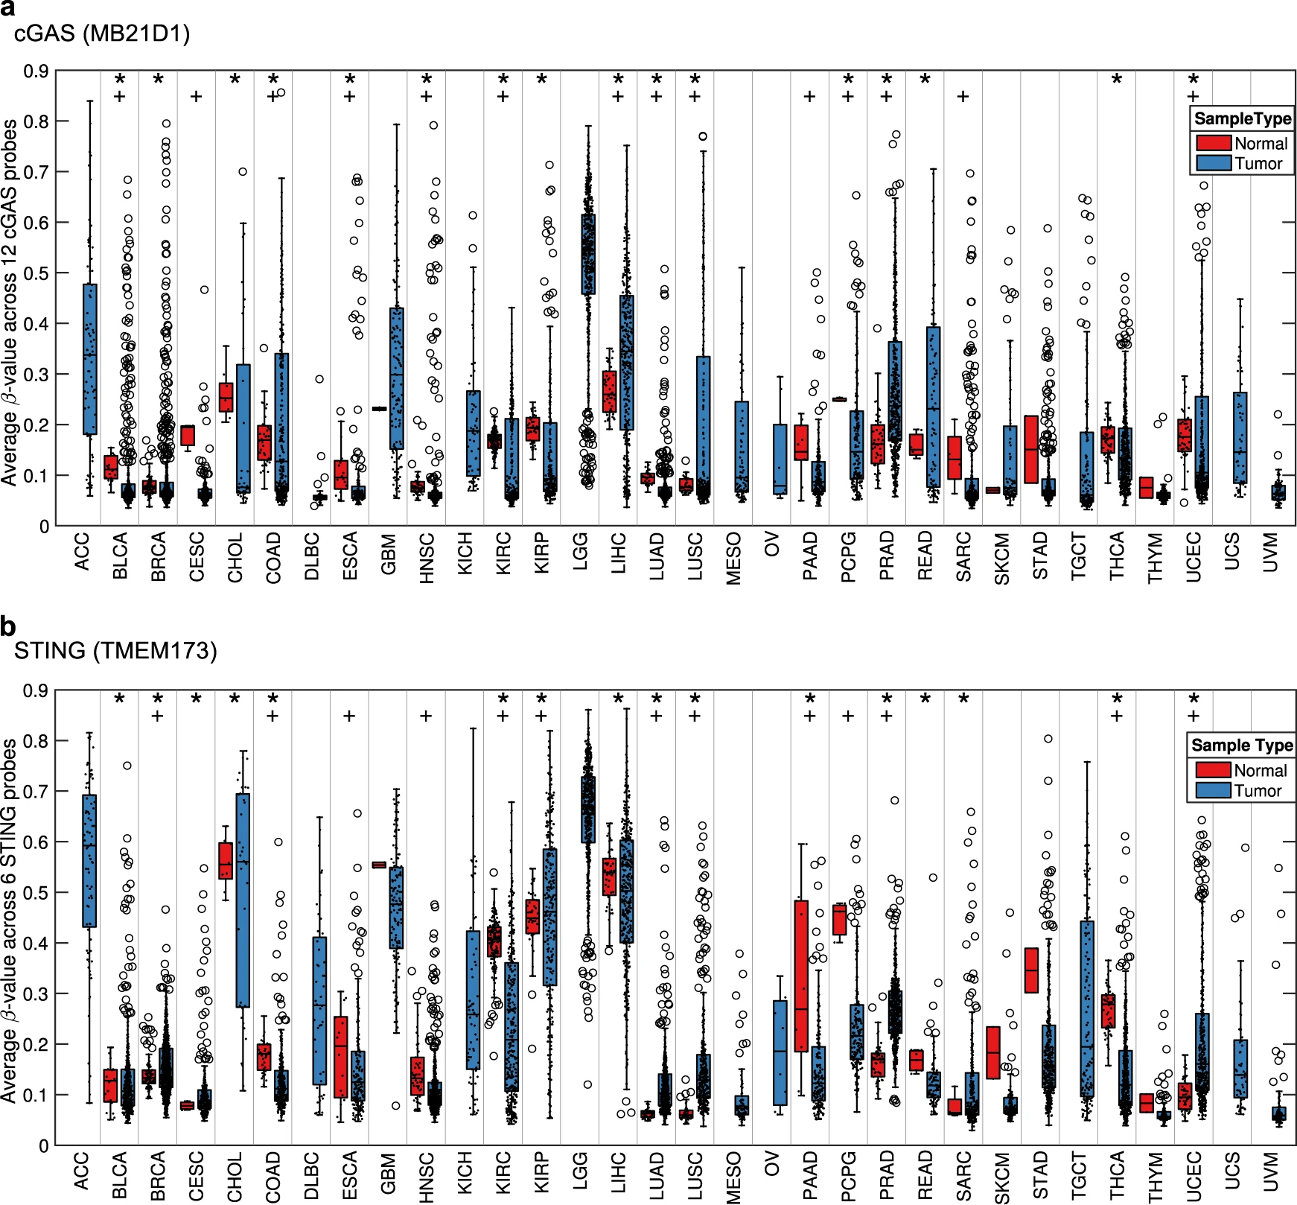
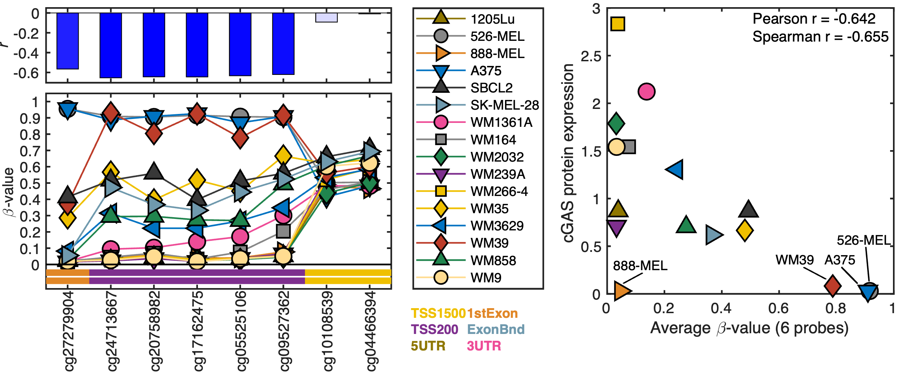
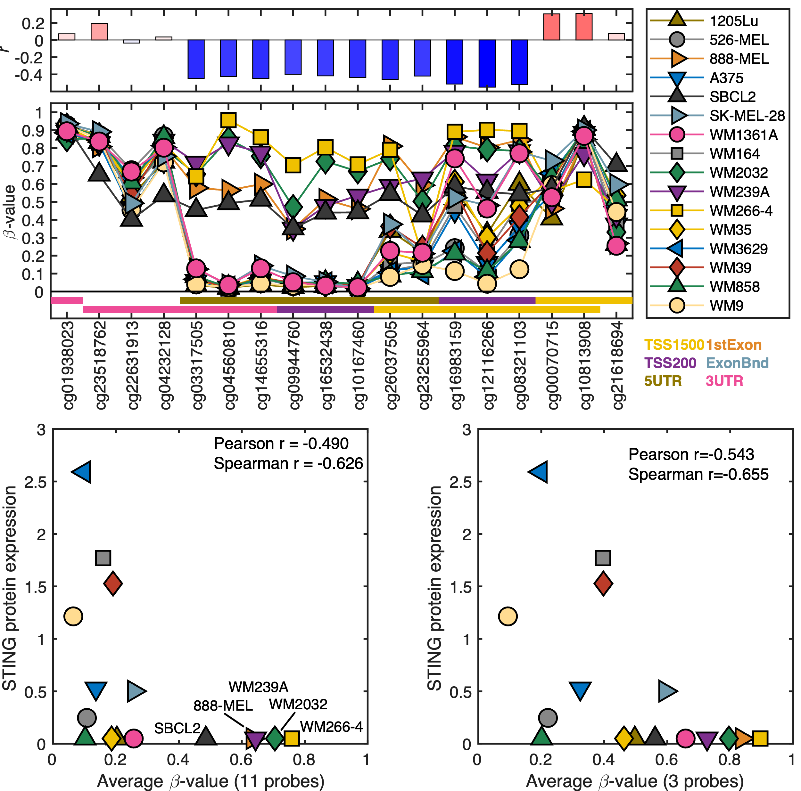
cGAS
STING
The average methylation level across 32 tumor types is shown in box plots for cGAS (a) or STING (b). Each individual sample is also represented by a dot (.) and outlier samples are indicated by circles (o). The statistical analysis was performed by Bartlett’s test (*; p < 0.05) and Fisher’s exact test for enrichment of tumors in the 75th percentile ( + ; p < 0.05).
Falahat R, Berglund A, Putney RM, Perez-Villarroel P, Aoyama S, Pilon-Thomas S, et al. Epigenetic reprogramming of tumor cell–intrinsic STING function sculpts antigenicity and T cell recognition of melanoma. PNAS 2021;118
Falahat R, Berglund A, Perez-Villarroel P, Putney RM, Hamaidi I, Kim S, et al. Epigenetic state determines the in vivo efficacy of STING agonist therapy. Nat Commun 2023;14:1573
Konno H, Yamauchi S, Berglund A, Putney RM, Mulé JJ, Barber GN. Suppression of STING signaling through epigenetic silencing and missense mutation impedes DNA damage mediated cytokine production. Oncogene. 2018 Apr;37(15):2037-2051. PMCID: PMC6029885.

Slide 7
cGAS
CpG-island
Gene
Body
Box-plots
16 CpG-probes for cGAS
Probe Ids
Genomic
location
Distance dependent (log)
β-value
0% methylation
100% methylation
Konno H, Yamauchi S, Berglund A, Putney RM, Mulé JJ, Barber GN. Suppression of STING signaling through epigenetic silencing and missense mutation impedes DNA damage mediated cytokine production. Oncogene. 2018 Apr;37(15):2037-2051

Slide 8
13(16) probes show a r<-0.3
cg09931909 is highly correlated but show high degree of methylation in most samples opposite to most other probes
Using these three graphs we can in an informed way summarize the methylation level of a gene
β-value

Slide 9
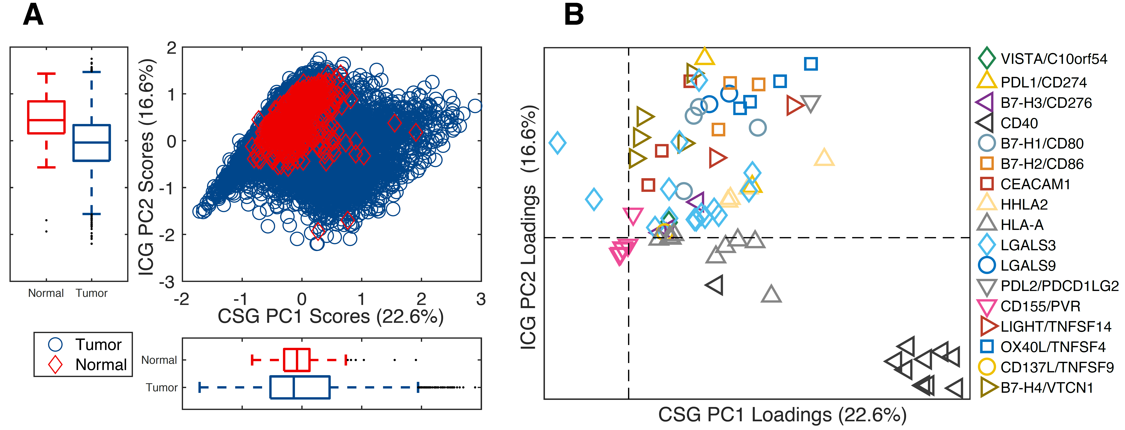
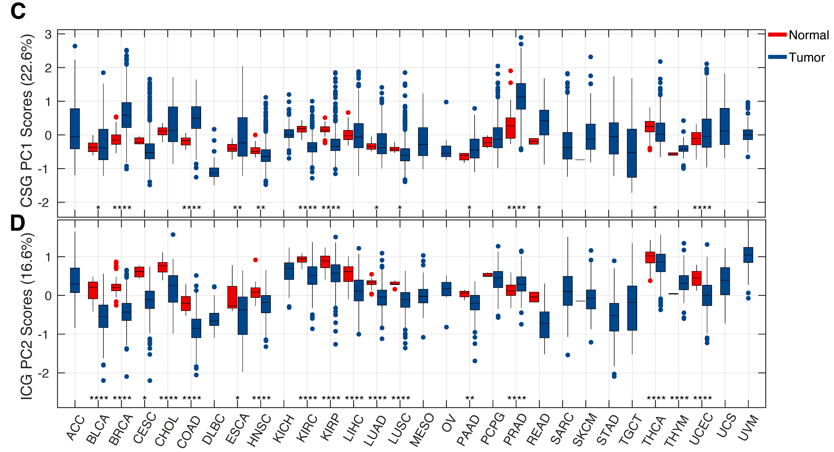
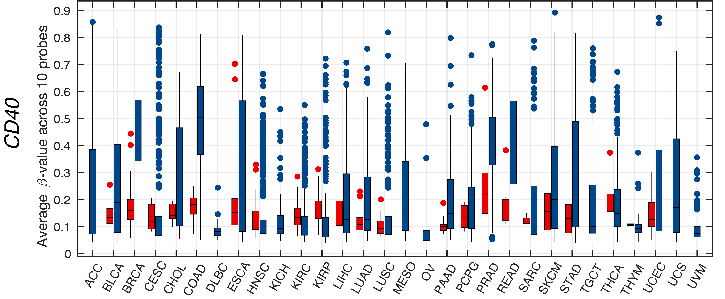
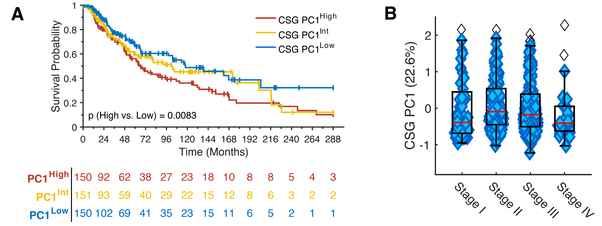
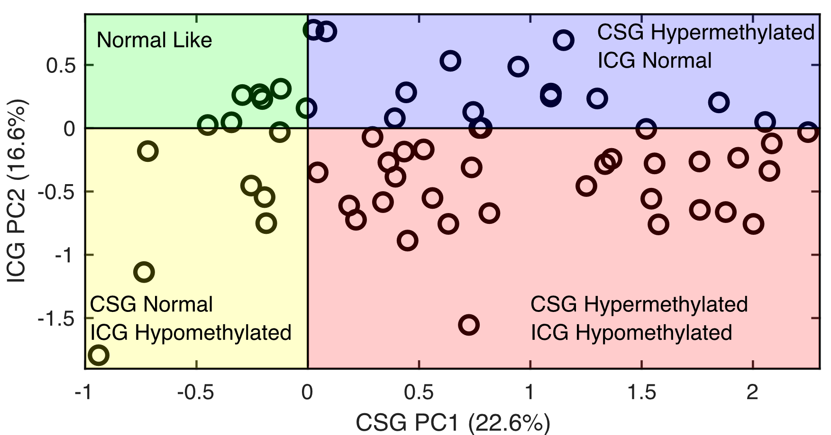
A
B
C
D
E
Berglund A, Mills M, Putney RM, Hamaidi I, Mulé J, Kim S. Methylation of immune synapse genes modulates tumor immunogenicity. J Clin Invest. 2020 Feb 3;130(2):974-980

Slide 10
Epigenetic effect of HPV16 infection in HNSC
In silico experiments using only public data
Current experiments is ongoing, based on our findings
Berglund A., et al. Characterization of Epigenomic Alterations in HPV16+ Head and Neck Squamous Cell Carcinomas. Cancer Epidemiol Biomarkers Prev. 2022 Apr 1;31(4):858-869. PMID: 35064062

Slide 11
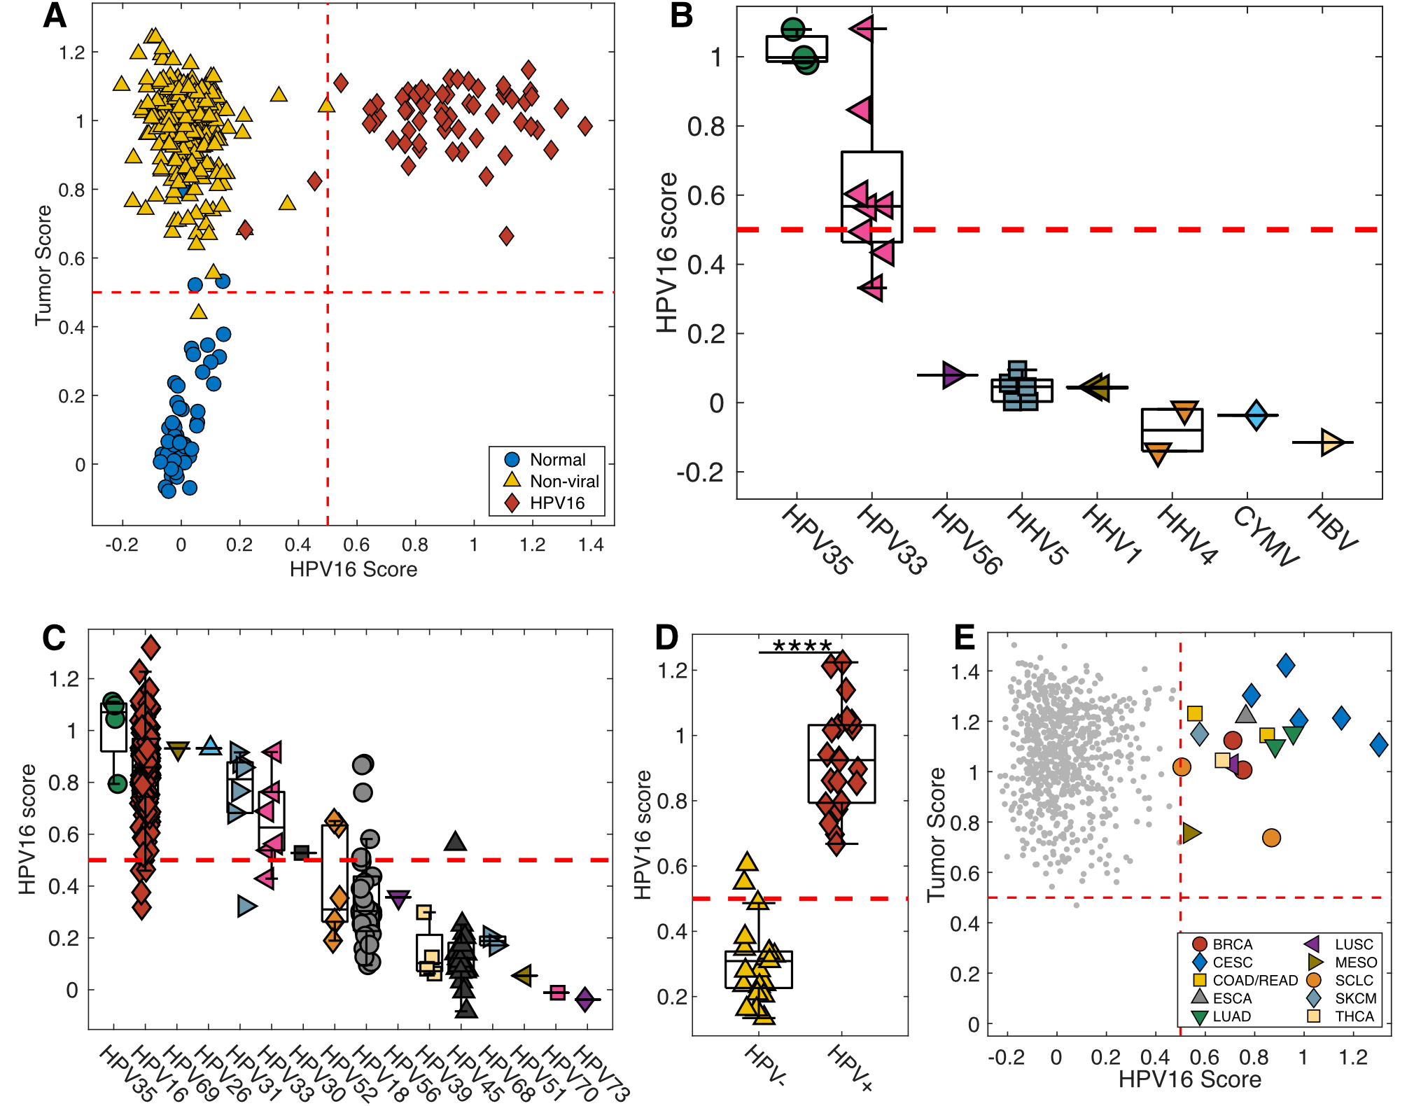
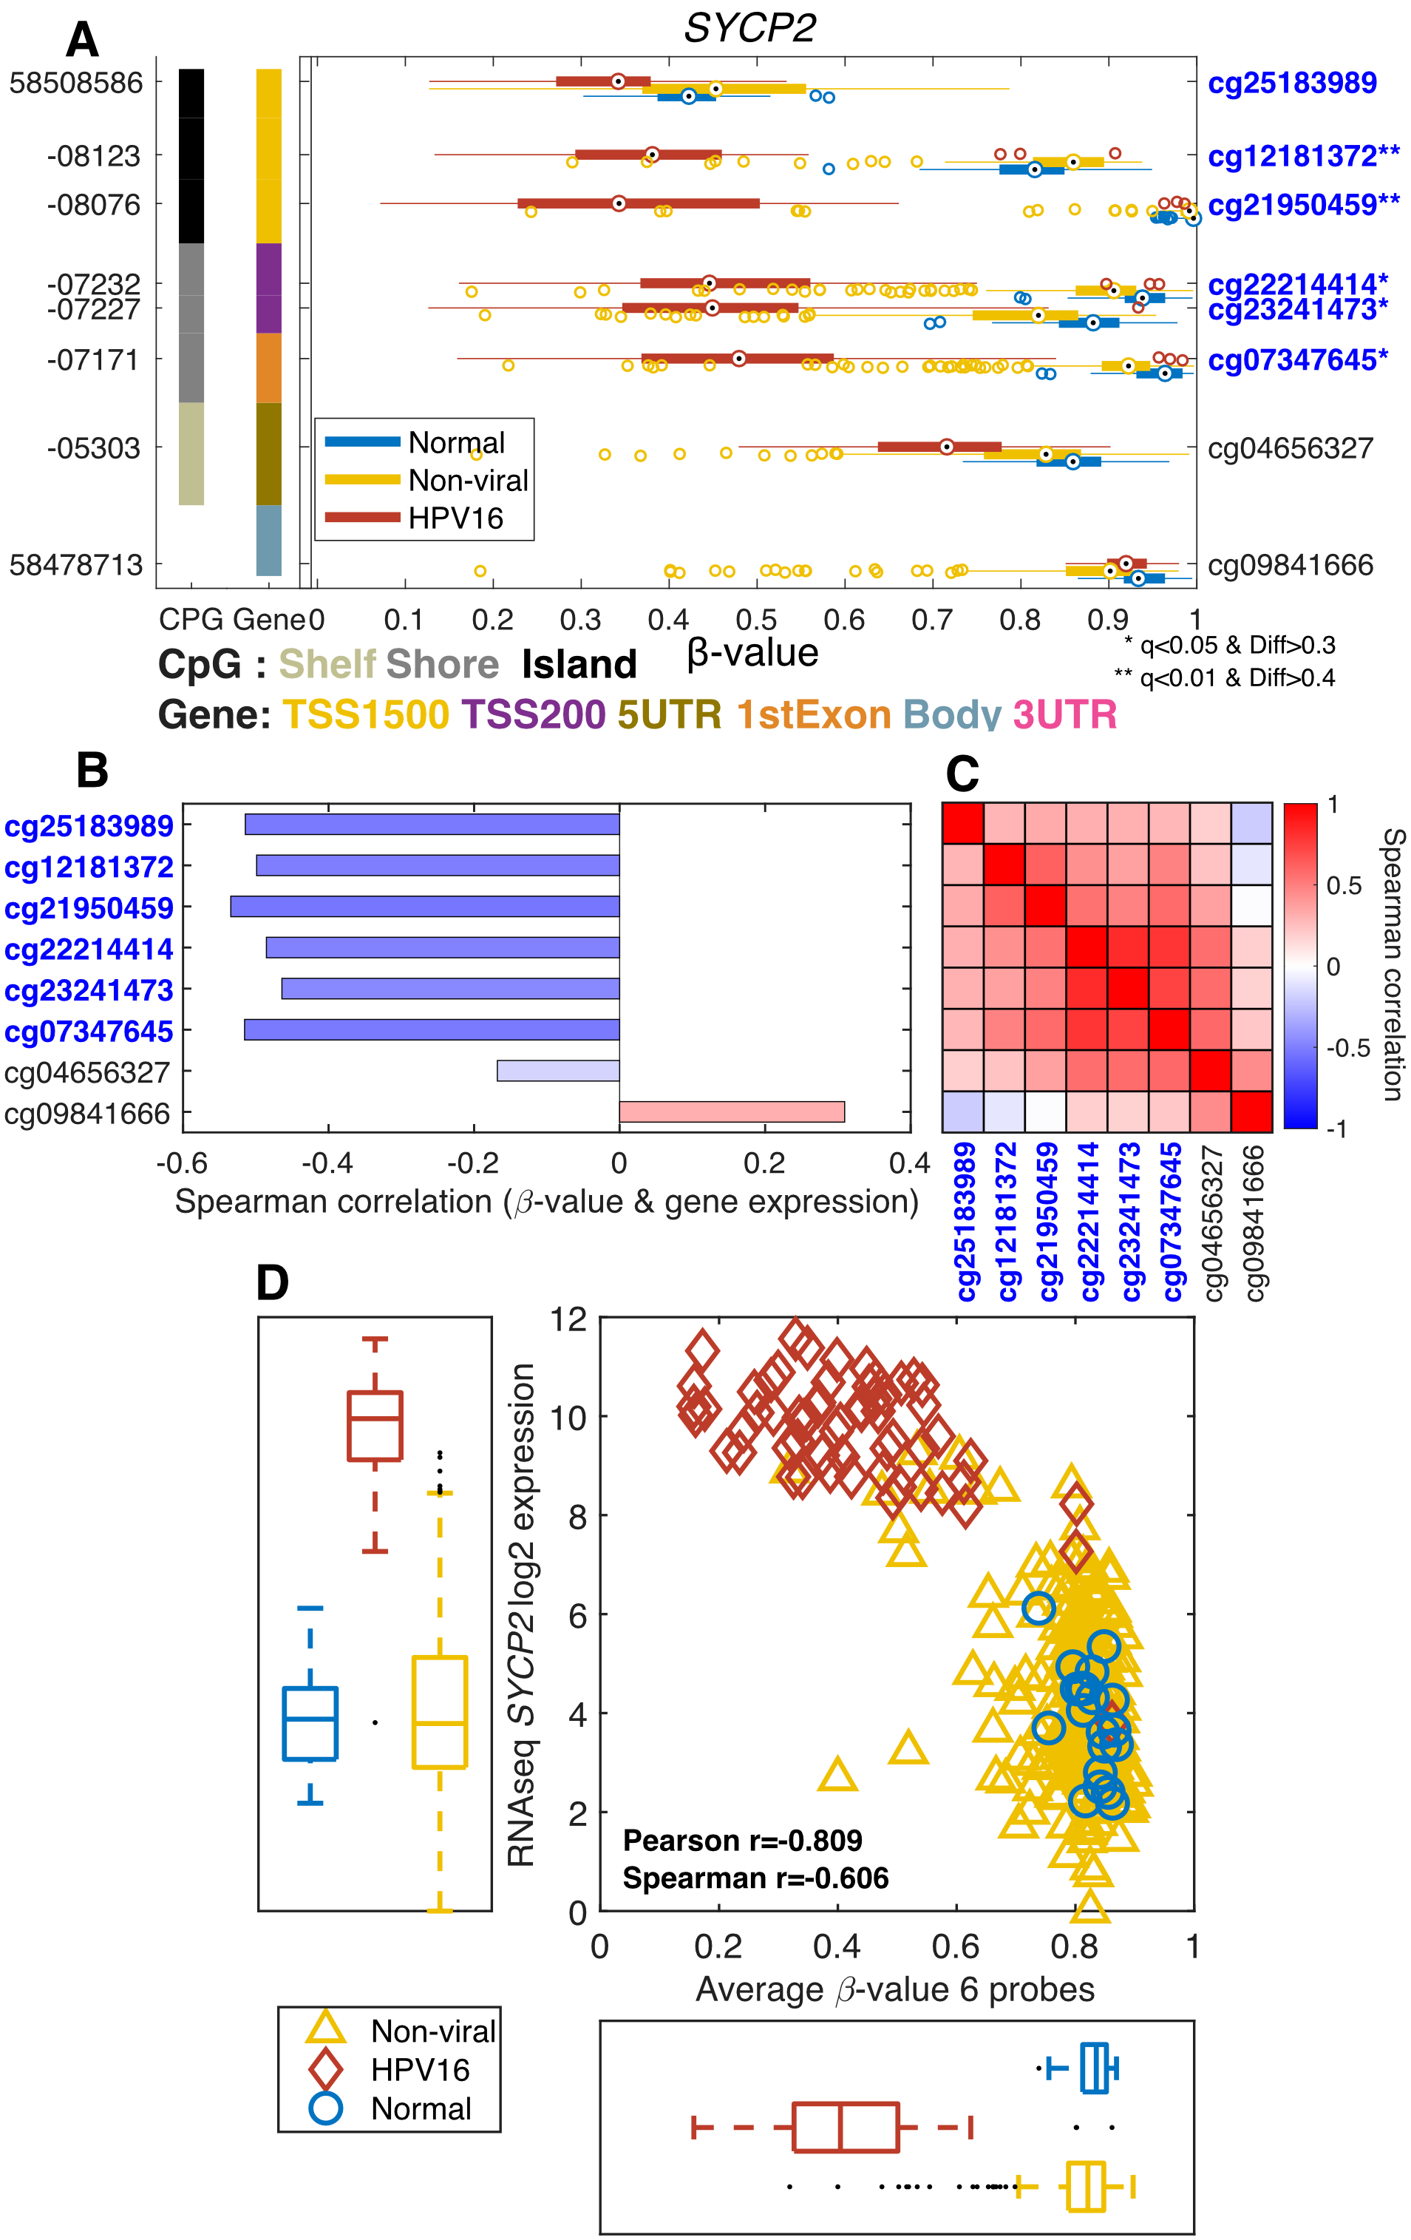
Berglund A., et al. Characterization of Epigenomic Alterations in HPV16+ Head and Neck Squamous Cell Carcinomas. Cancer Epidemiol Biomarkers Prev. 2022 Apr 1;31(4):858-869. PMID: 35064062

Slide 12
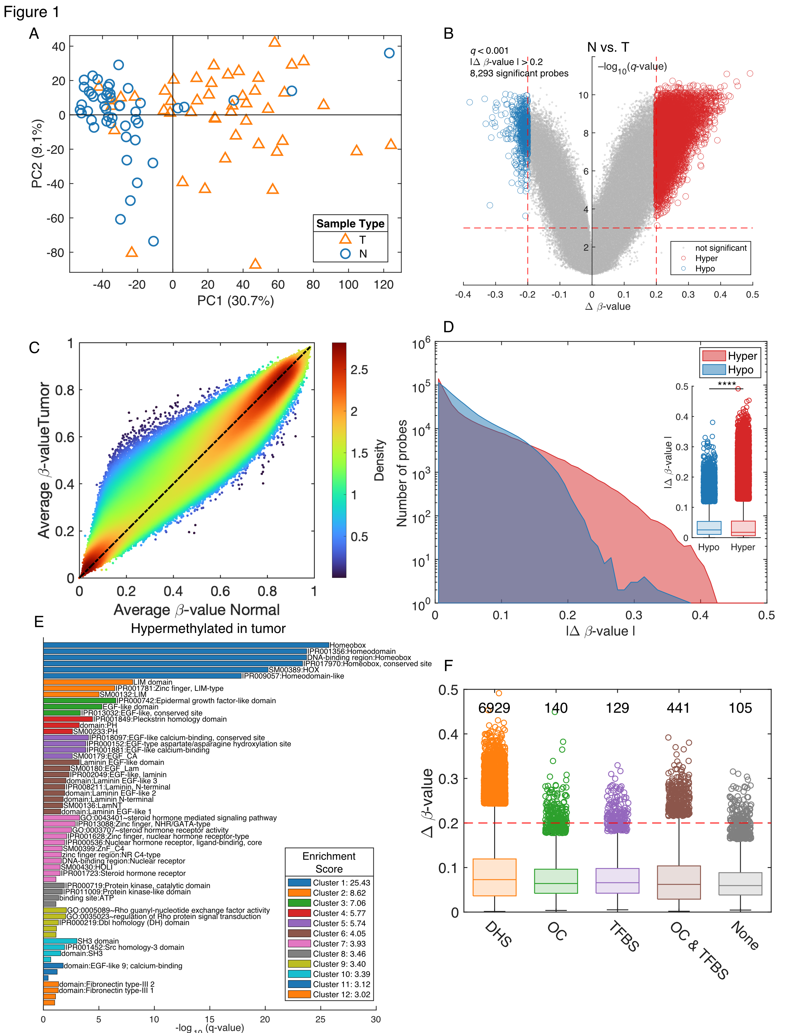
Epigenome-wide studies or Hypothesis-generating studies
There are many ways to analyze the data
Challenges
A limited number of samples
Retrospective cohorts
Additional cell line and mouse work is needed
Potential solutions
Keep it simple, ask specific questions
Use additional public datasets
Examples
Epigenomic characterization of locally advanced anal cancer: a radiation therapy oncology group 98-11 specimen study. [1]
Genome-wide host methylation profiling of anal and cervical carcinoma [2]
Dysregulation of DNA Methylation and Epigenetic Clocks in Prostate Cancer among Puerto Rican Men [3]
Segregation of HPV-positive Vulvar Neoplastic Lesions by Methylation [4]
Epigenome-wide association study of Prostate Cancer in African American Men identified differentially methylated immune genes and dysregulation of epigenetic clocks [5]
Siegel EM, Eschrich S, Winter K, Riggs B, Berglund A, Ajidahun A, et al. Epigenomic characterization of locally advanced anal cancer: a radiation therapy oncology group 98-11 specimen study. Dis Colon Rectum 2014;57:941–57.
Siegel EM, Ajidahun A, Berglund A, Guerrero W, Eschrich S, Putney RM, et al. Genome-wide host methylation profiling of anal and cervical carcinoma. PLoS One 2021;16:e0260857.
Berglund A, Matta J, Encarnación-Medina J, Ortiz-Sanchéz C, Dutil J, Linares R, et al. Dysregulation of DNA Methylation and Epigenetic Clocks in Prostate Cancer among Puerto Rican Men. Biomolecules 2022;12:2.
Ajidahun A, Berglund A, et al. Segregation of HPV-positive Vulvar Neoplastic Lesions by Methylation, Manuscript in preparation
Berglund, Anders, Kosj Yamoah, Steven A. Eschrich, Rana Falahat, James J. Mulé, Sungjune Kim, Jaime Matta, et al. “Epigenome-Wide Association Study of Prostate Cancer in African American Men Identified Differentially Methylated Genes.” Cancer Medicine 13, no. 16 (2024)

Slide 13
Data (Dr. Park)
PCa AA
120 Tumors, 121 Normal
Gleason Grade:
5+6 n=26
7 n=72
8+9 n=22
EPIC methylation
Analysis
Are immune-related pathways silenced in AA PCa tumors?
Immune synapse genes
STING/cGAS signaling
What are differently methylated?
Genes and/or global trends
Berglund A, Putney RM, Hamaidi I, Kim S. Epigenetic dysregulation of immune-related pathways in cancer: bioinformatics tools and visualization. Exp Mol Med 2021;53:761–71
Berglund A, Putney RM, Hamaidi I, Kim S. Epigenetic dysregulation of immune-related pathways in cancer: bioinformatics tools and visualization. Exp Mol Med. 2021 May;53(5):761–71.

Slide 14
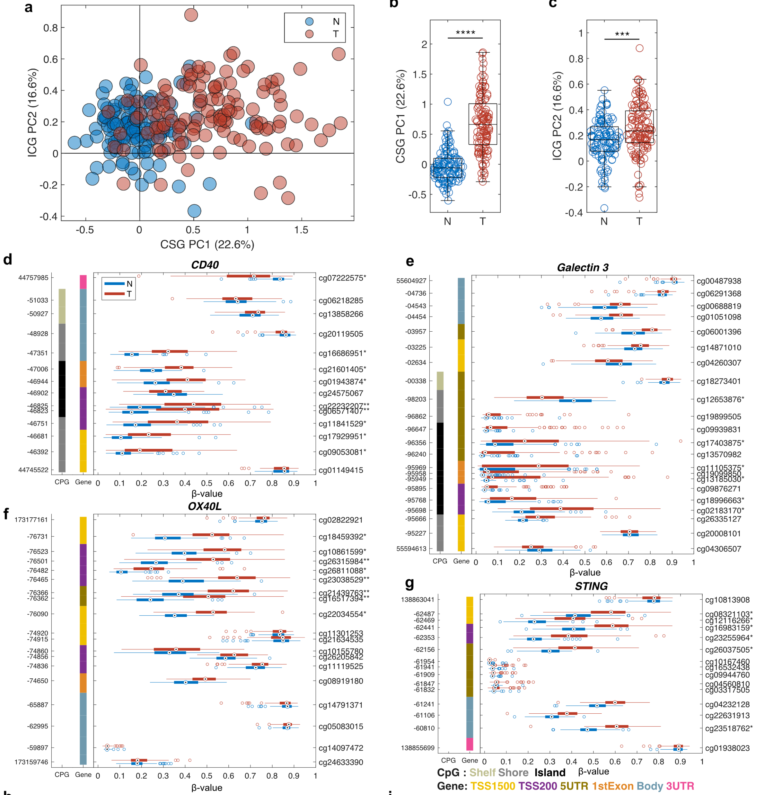
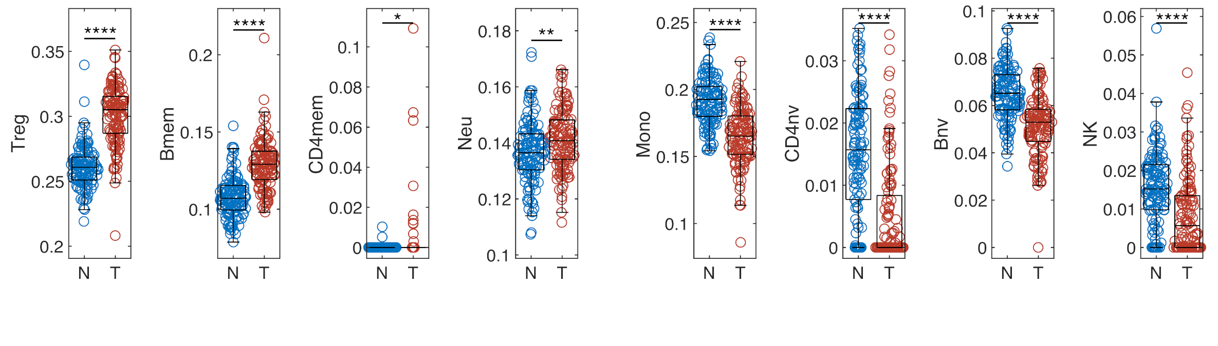
Berglund, Anders, Kosj Yamoah, et al. “Epigenome-Wide Association Study of Prostate Cancer in African American Men Identified Differentially Methylated Genes.” Cancer Medicine 13, no. 16 (2024)

Slide 15
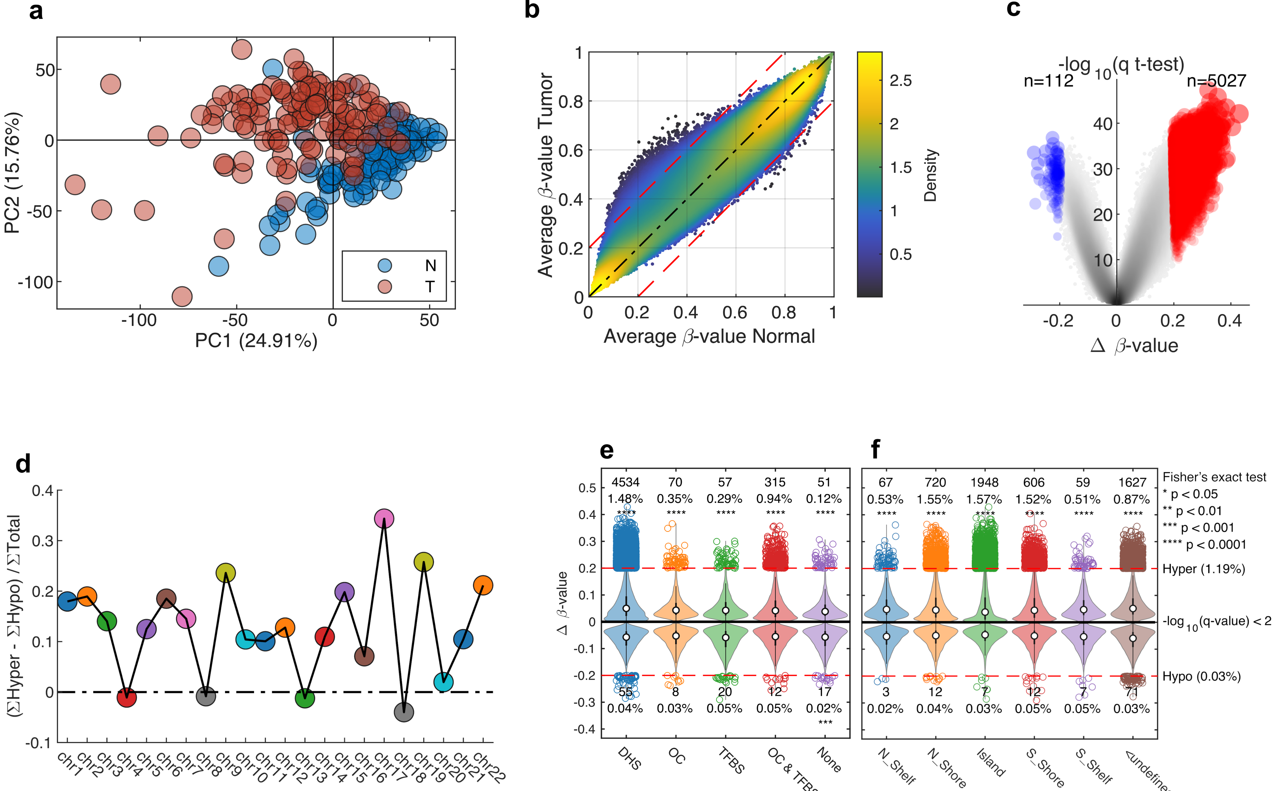
Berglund, Anders, Kosj Yamoah, et al. “Epigenome-Wide Association Study of Prostate Cancer in African American Men Identified Differentially Methylated Genes.” Cancer Medicine 13, no. 16 (2024)
DNase Hypersensitivity CpG-probes (DHS), Open Chromatin probes (OC), Transcription factor binding sites (TFBS).

Slide 16
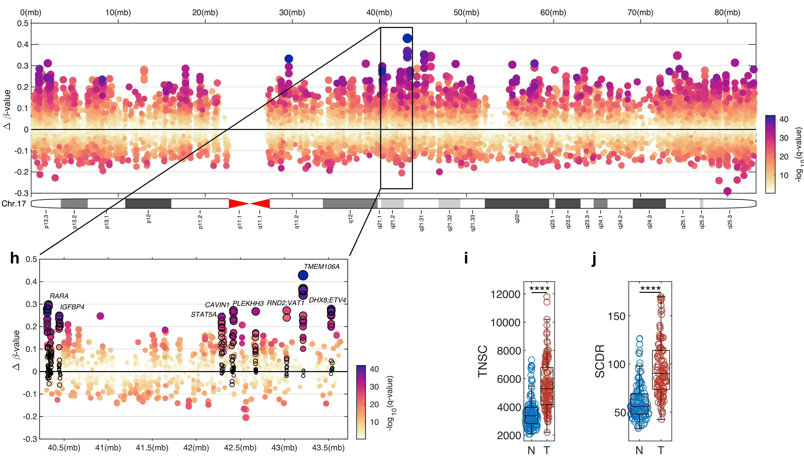
Berglund, Anders, Kosj Yamoah, et al. “Epigenome-Wide Association Study of Prostate Cancer in African American Men Identified Differentially Methylated Genes.” Cancer Medicine 13, no. 16 (2024)
TNSC: total number of stem cell divisions per stem cell
SCDR: stem cell division rate

Slide 17
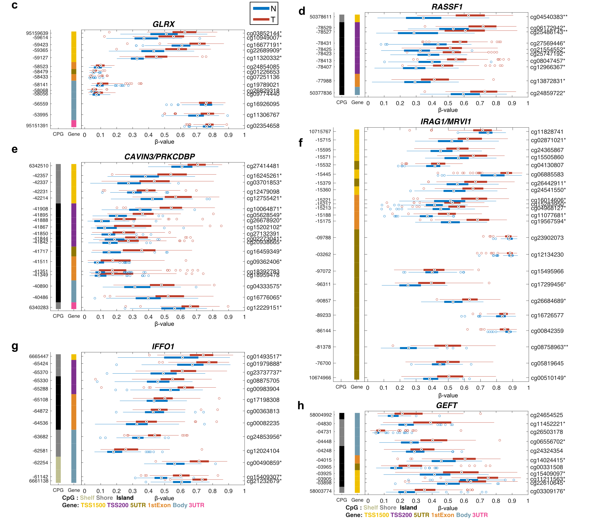
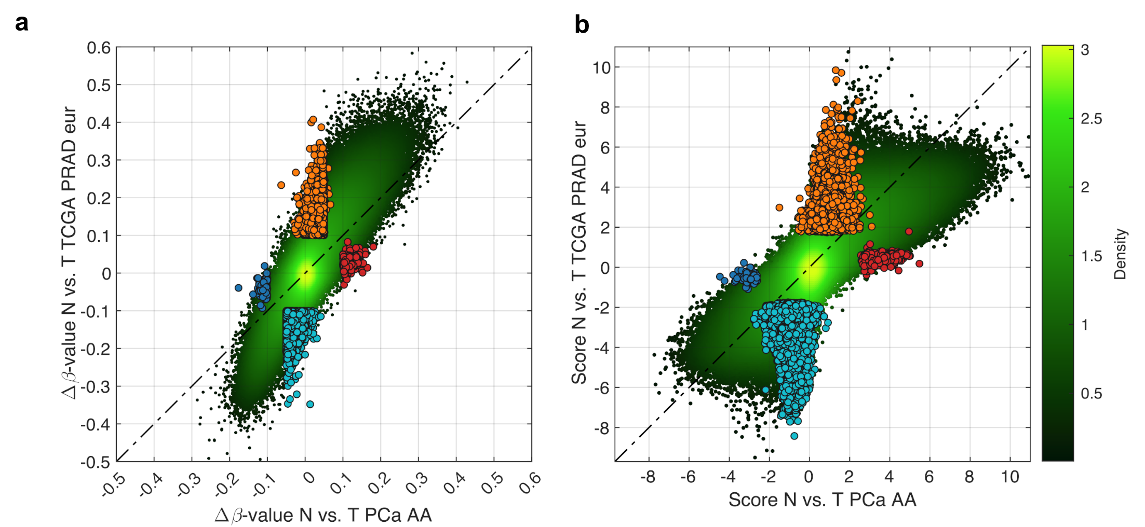
Berglund, Anders, Kosj Yamoah, et al. “Epigenome-Wide Association Study of Prostate Cancer in African American Men Identified Differentially Methylated Genes.” Cancer Medicine 13, no. 16 (2024)

Slide 18
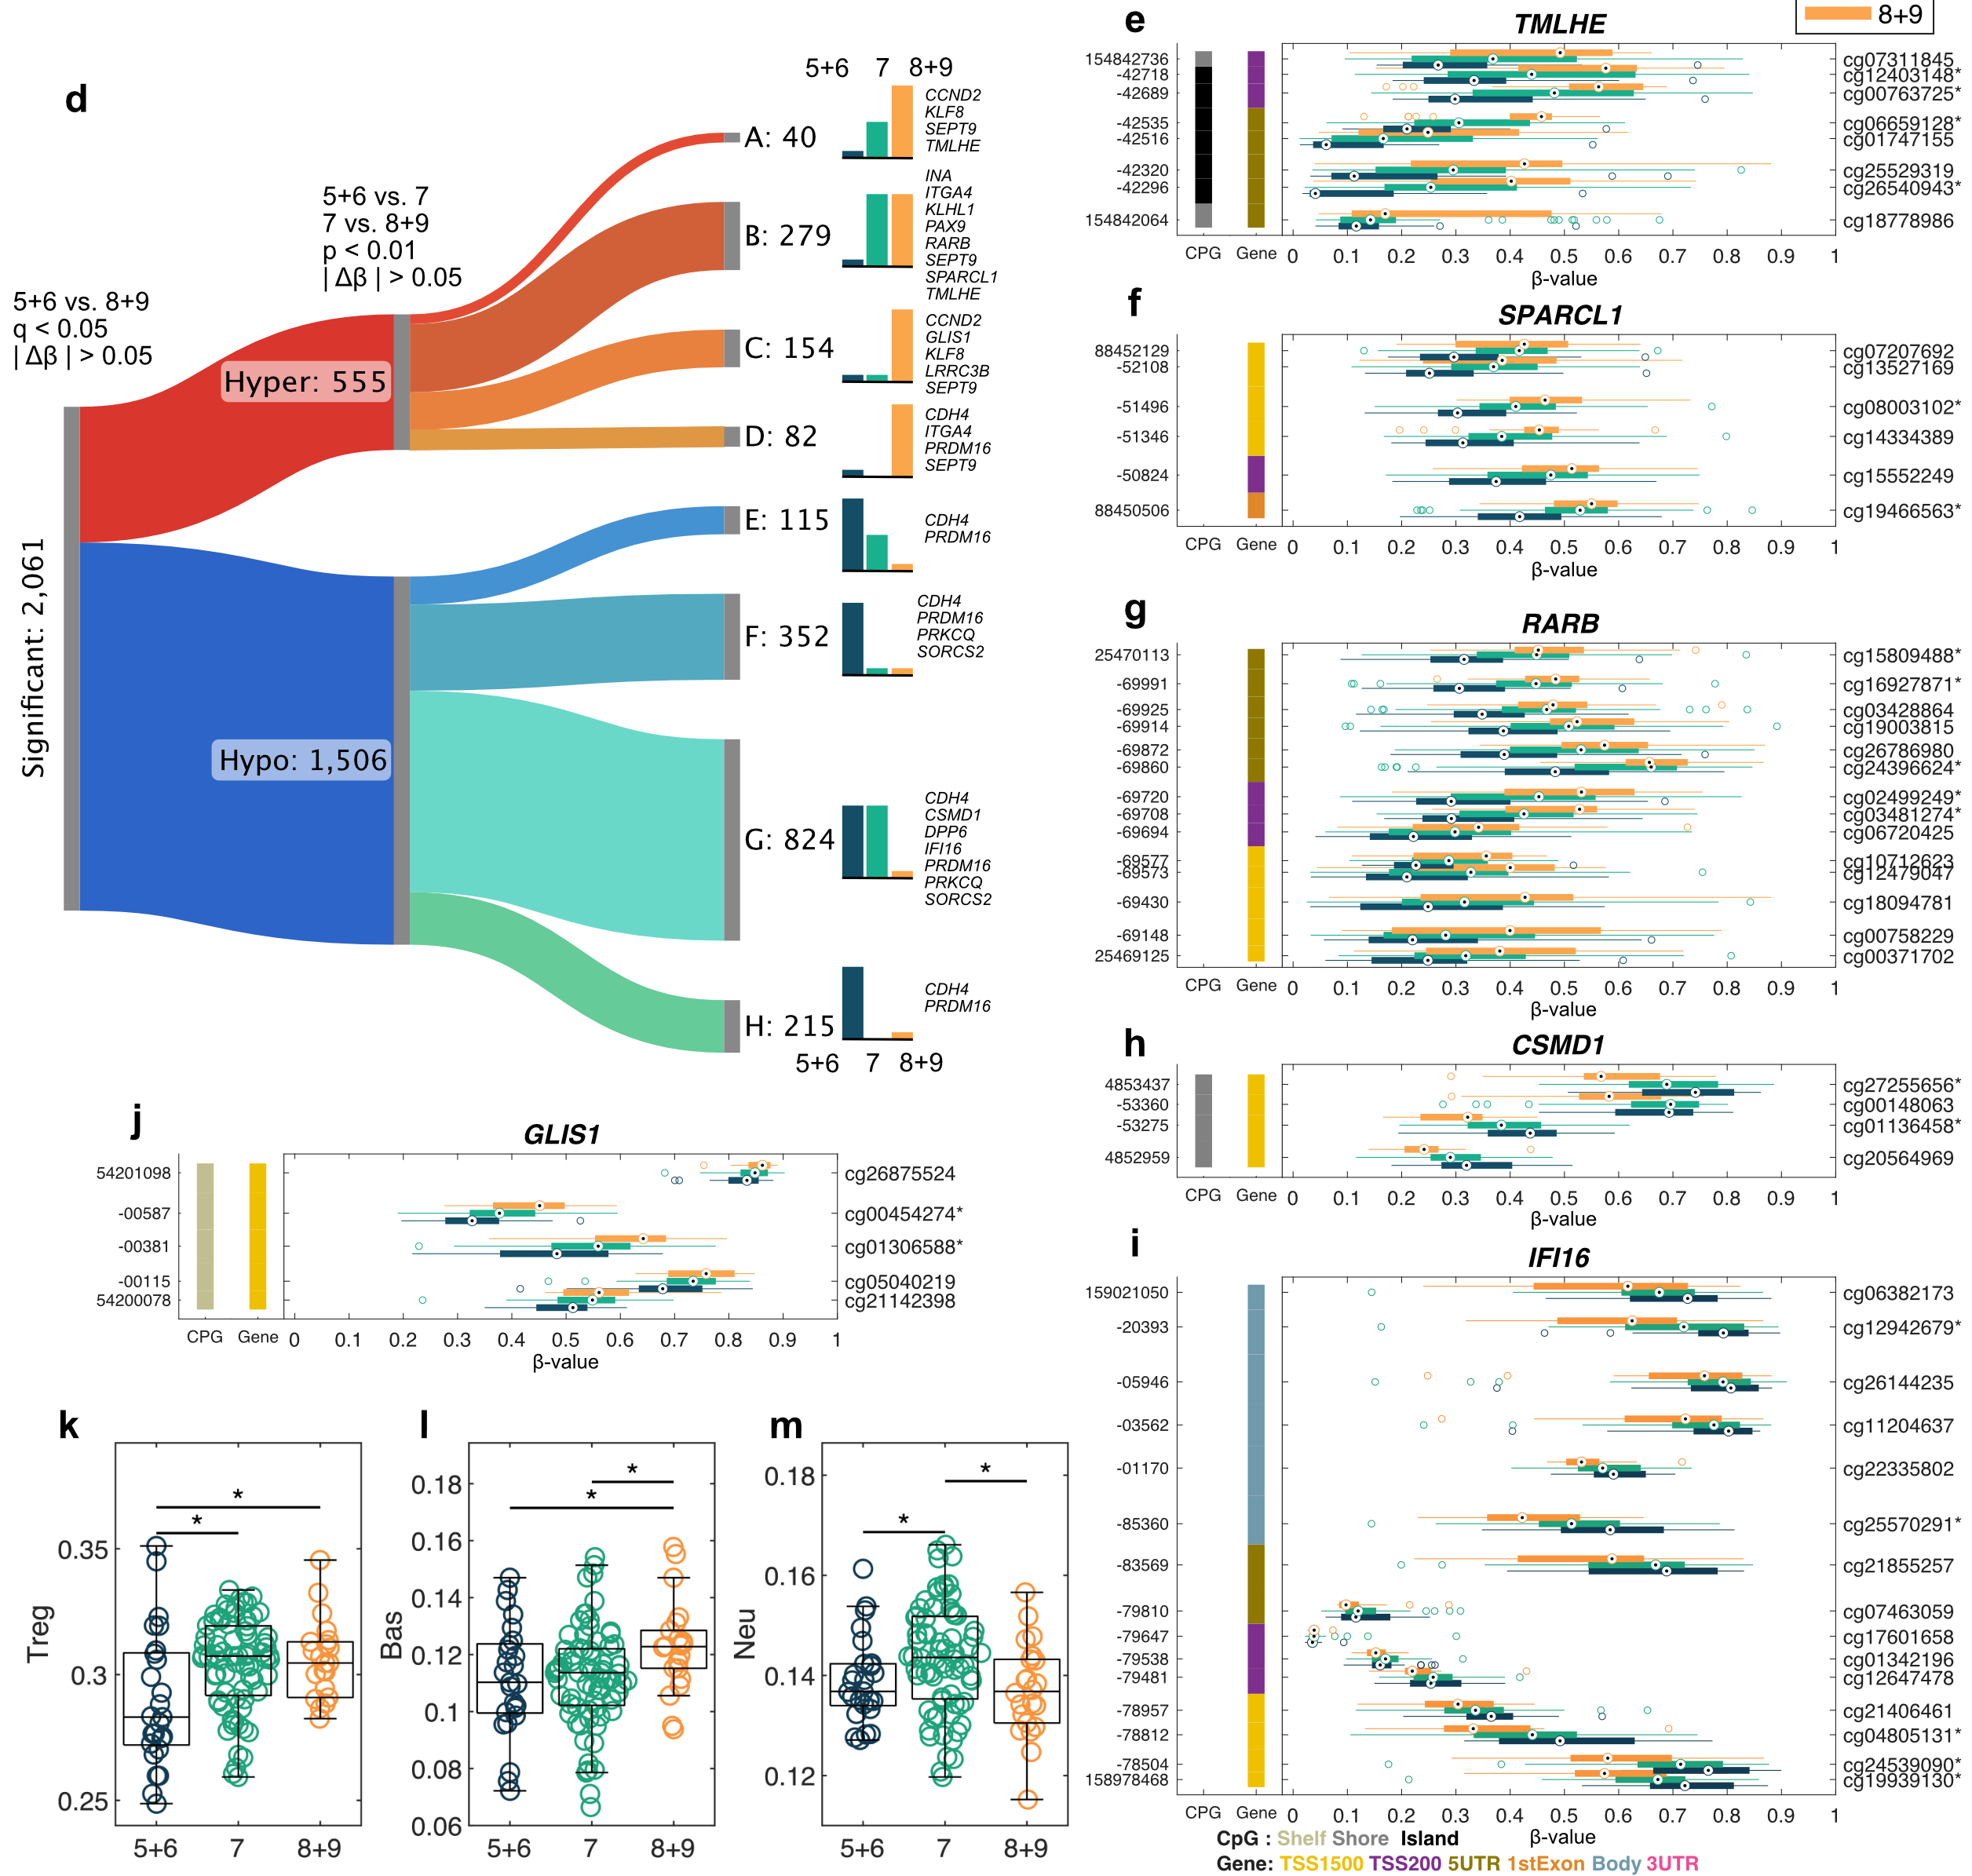
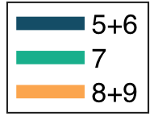
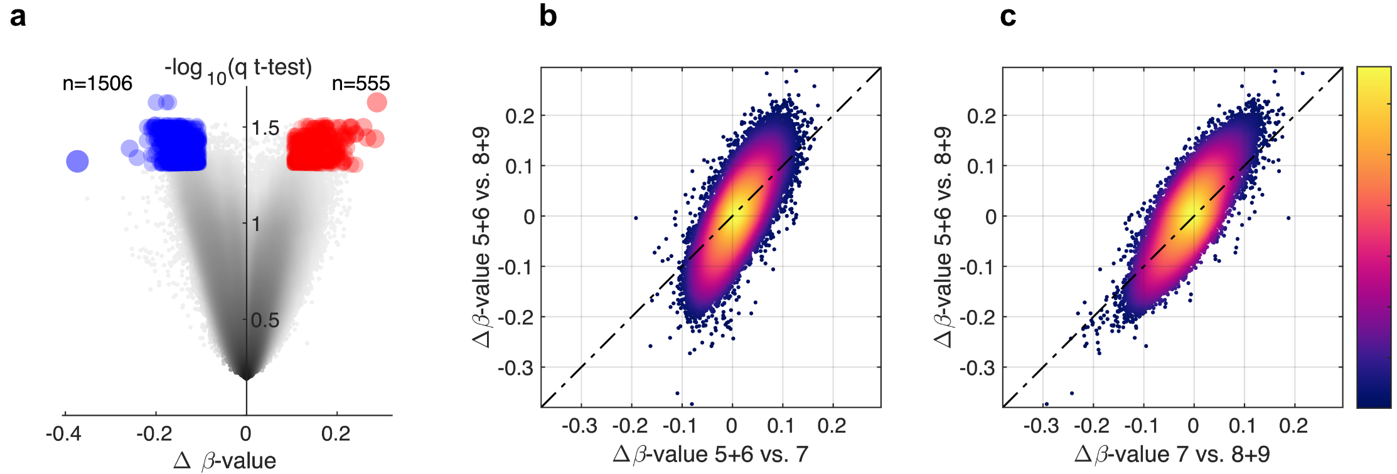
Berglund, Anders, Kosj Yamoah, et al. “Epigenome-Wide Association Study of Prostate Cancer in African American Men Identified Differentially Methylated Genes.” Cancer Medicine 13, no. 16 (2024)

Slide 19
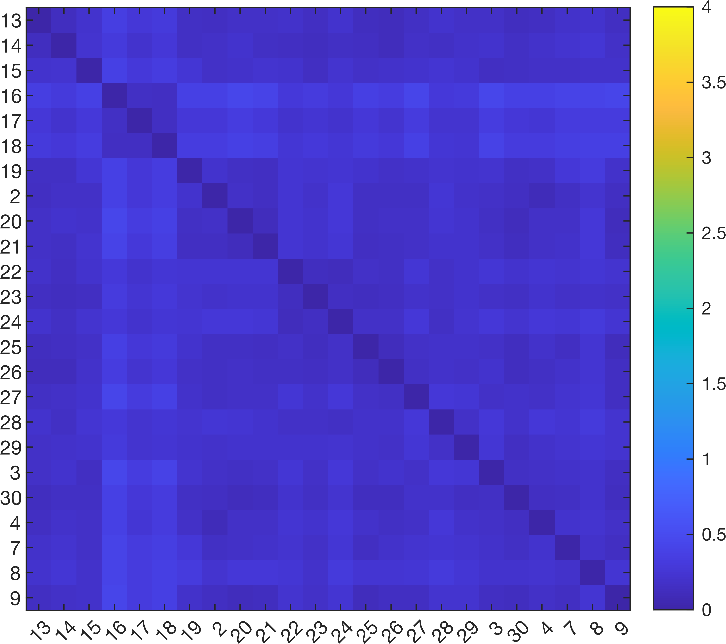
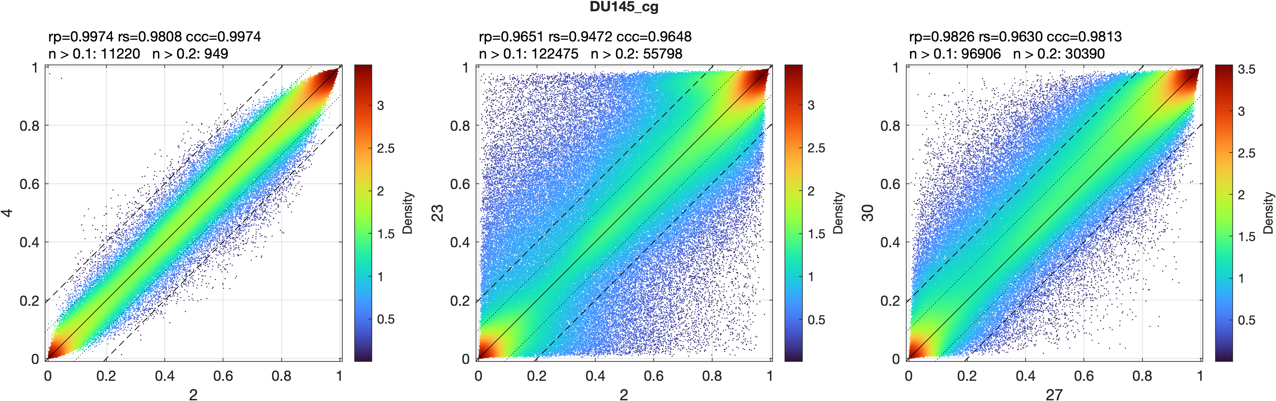

Slide 20
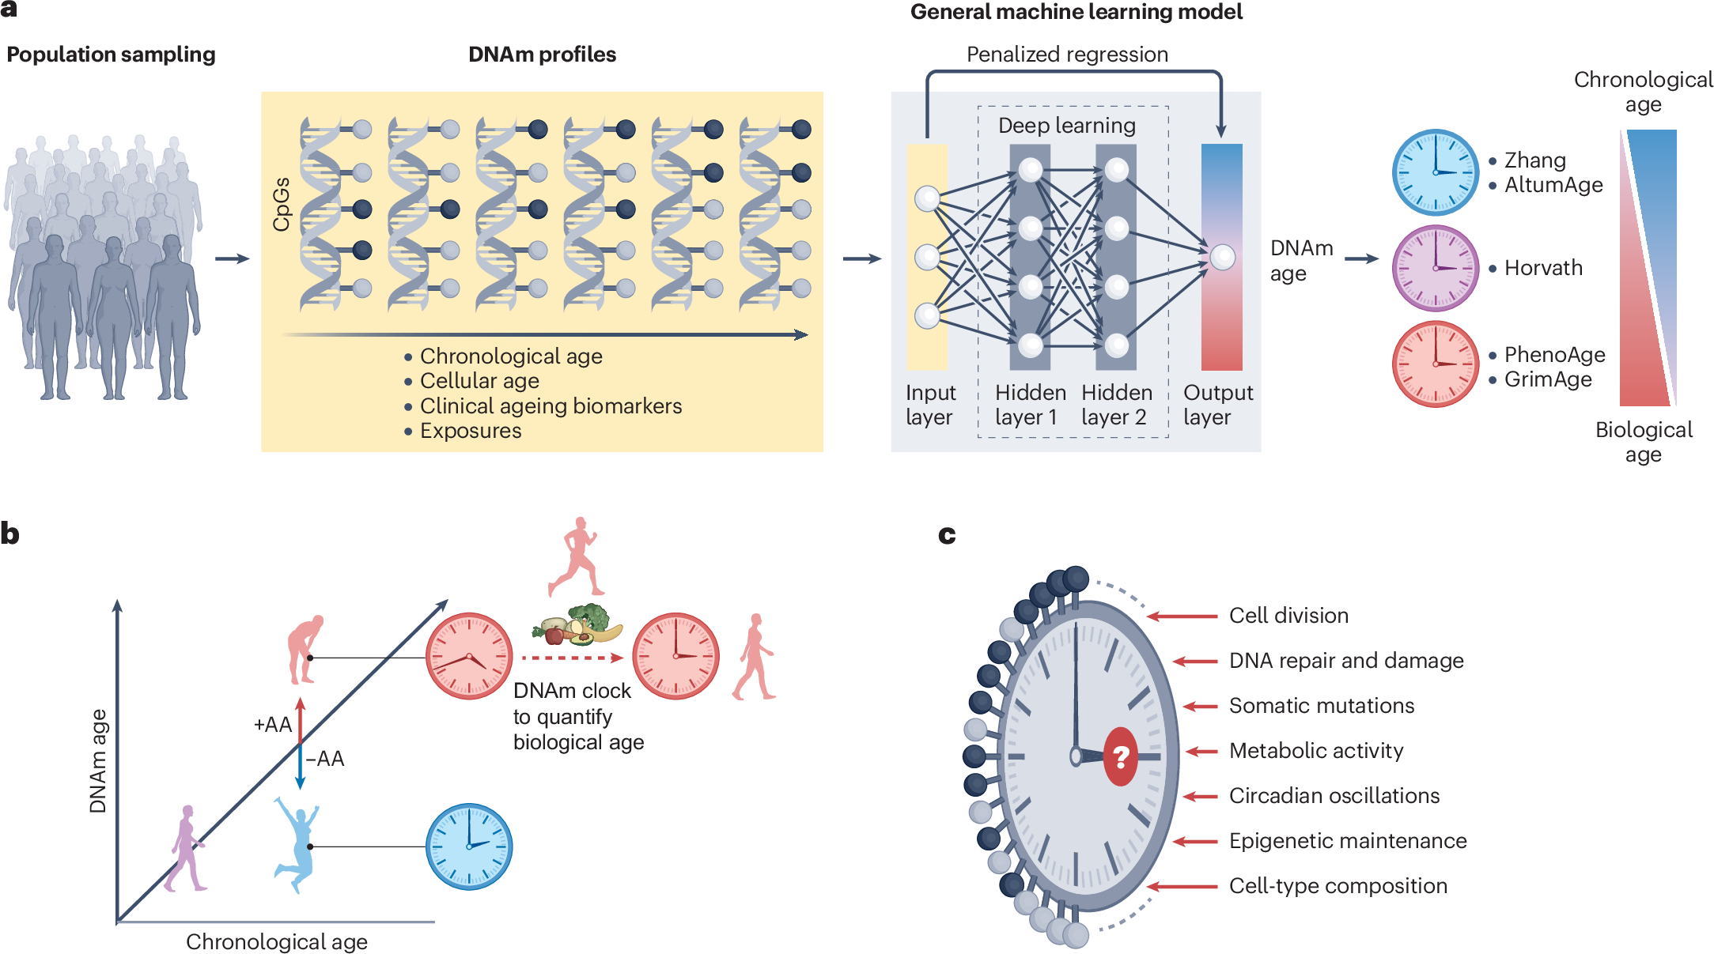
Teschendorff, Andrew E., and Steve Horvath. “Epigenetic Ageing Clocks: Statistical Methods and Emerging Computational Challenges.” Nature Reviews Genetics, January 13, 2025, 1–19.
Mammadova, Jamila, Alicia Richards, Adriana Gonzalez-Torriente, Evan R. Adler, Rachel J. Cruz, Stefanie Palfi, Dae Hyun Lee, et al. “Methylation-Based Biological Age and Cardiotoxicity Risk in Breast Cancer Patients Treated with Trastuzumab.” Cardio-Oncology 2025
Dickey, Brittney L., Ryan M. Putney, Gita Suneja, Jacob K. Kresovich, Adam M. Spivak, Ami B. Patel, Mingxiang Teng, et al. “Differences in Epigenetic Age by HIV Status among Patients with a Non-AIDS Defining Cancer.” AIDS (London, England), July 18, 2023

Slide 21
Acknowledgment - My collaborators
Asmaa Elkenawi, PhD
Sungjune Kim, MD, PhD
Brook Fridley, PhD
John Cleveland, PhD
Jim Mulé, PhD
Rana Falahat, PhD
Prostate & Health Disparities
Yong Park, PhD
Kosj Yamoah, MD
Steven Eschrich, PhD
GBM
Arnie Etame, MD
Epigenetic clocks
Jacob Kresovich, PhD
Anna Giuliano, PhD
Anna Coghill, PhD
Kidney
Brandon Manley, MD PhD
Methylation
David Shibata, MD, PhD
Erin Siegel, PhD
The results shown here are based in part upon data generated by the TCGA Research Network: https://www.cancer.gov/tcga

Slide 22
Thanks!
Questions?

